Slide 1

Career Trends Explorer and Personalized Job Matcher
Forecasting Future Workforce Trends
NAME: MINAL DEVIKAR
INSTITUTION:DIGICHROME ACADEMY

Slide 2

INTRODUCTION
Project Scope
Project Purpose
Analyze and forecast career trends in the workforce. Match personalized job opportunities based on future job market forecasts. Focus on high-demand job sectors, such as remote work and technology.
Utilize historical job data to make predictions. Provide actionable insights for both job seekers and employers.

Slide 3
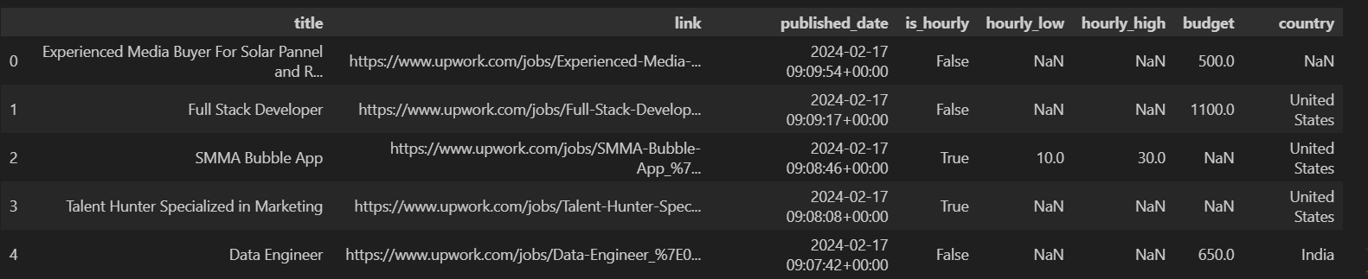
DATA OVERVIEW
Key Dataset Features
Data Sources
Job title, salary range, country, and job type (remote/full-time/part-time). Historical job postings data by year and month. Metrics such as job count, remote job count, and budget data.
Collected from multiple job boards and career websites.

Slide 4

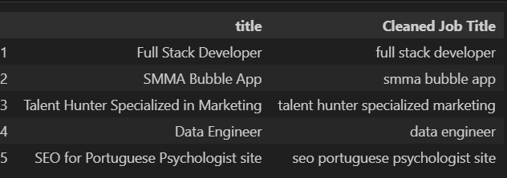
DATA PREPROCESSING
Cleaning and Preparing Data
Creating New Columns
Grouping and Aggregating
Creating new columns, such as 'YearMonth' for time-series analysis.
Grouping and aggregating data by year and job type for better forecasting.
Handling missing values and inconsistencies.

Slide 5
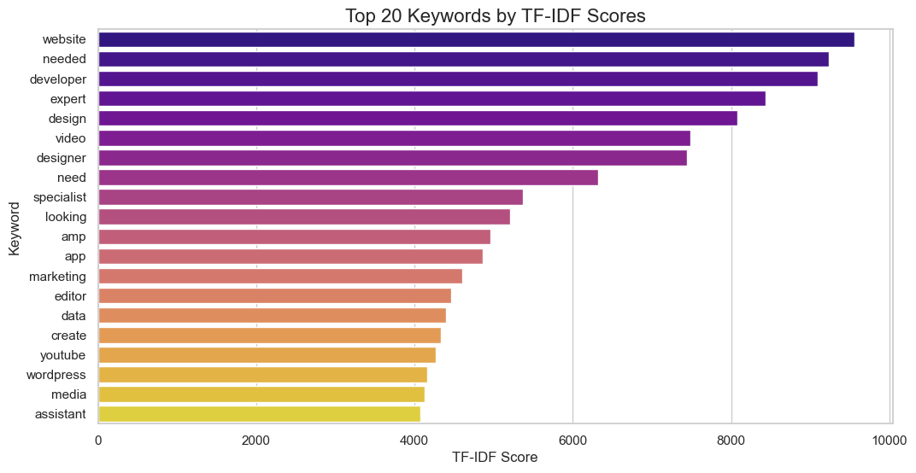
- High TF-IDF Scores: "Website" and "needed" rank highest, reflecting their specificity in job titles.
- Technical Skills: Keywords like "developer," "design," and "video" emphasize demand for tech and creative roles. Specialized Expertise: Terms such as "specialist" and "expert" highlight a need for niche professionals.
- Content and Marketing: Words like "marketing," "YouTube," and "WordPress" show focus on digital content creation.

Slide 6
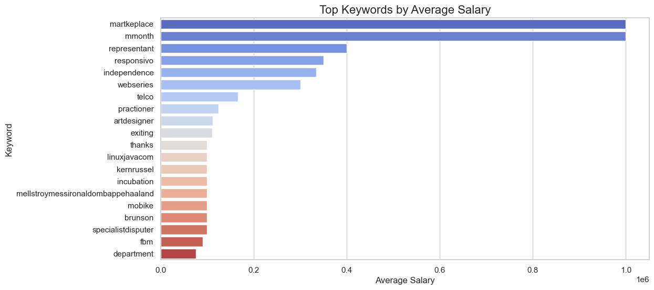
Task 1: Analyzing Keywords and Salaries
High-Salary Keywords: Niche roles like marketplace and month offer high earnings.
Earning Potential: Keywords such as representative signal lucrative opportunities.
Emerging Roles: Unconventional terms like webseries suggest growing job markets.
Generalized Roles: Keywords like department reflect less lucrative, broader roles.

Slide 7
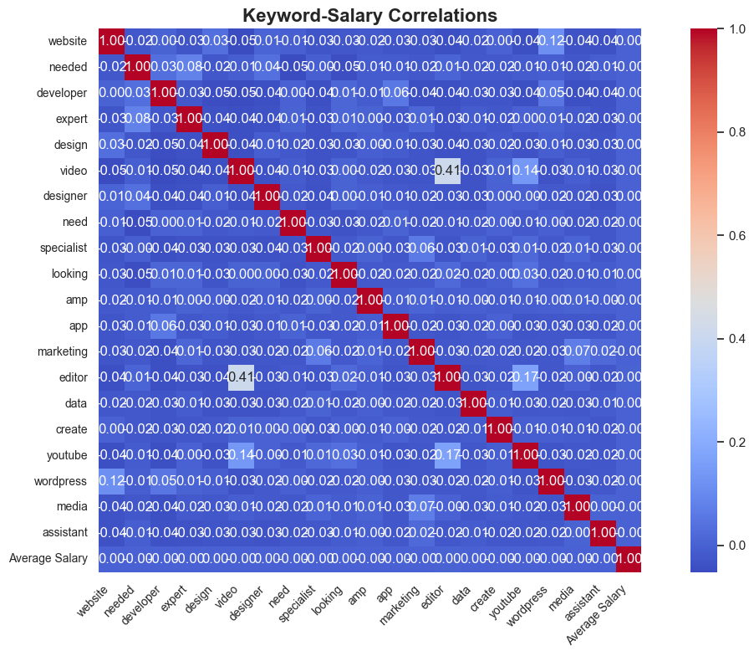
Correlation Analysis
Low Salary Correlation: Most keywords show weak links to salary, implying broader factors at play.
Positive Correlation: Terms like "Editor" and "Design" show moderate correlation (~0.41), linking them to higher salaries.
Negligible Impact: Keywords like "Website," "Developer," and "Marketing" have minimal or no salary correlation.
Key Insight: Specialized skills, such as editing and design, may have a stronger influence on salary.

Slide 8
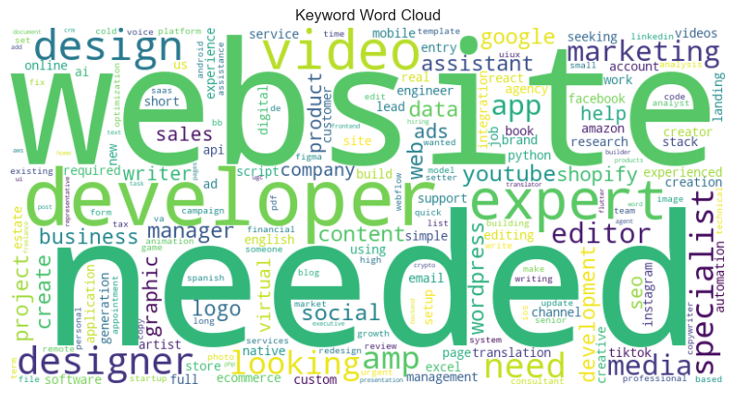
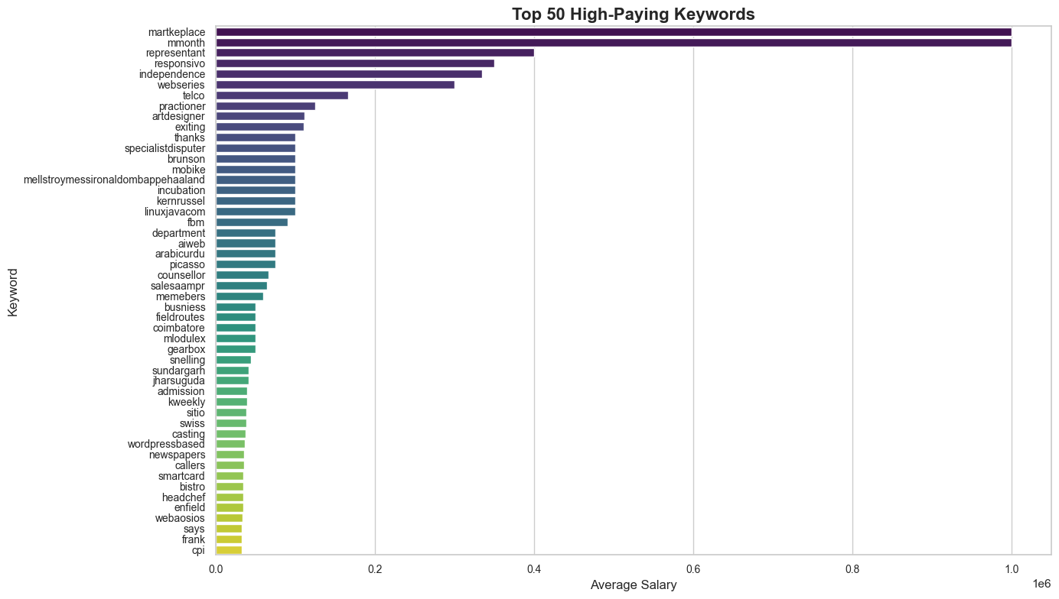
Word Cloud For The Most Frequent Keywords
Top 50 High-Paying Keywords
This word cloud highlights frequently used terms in project or task postings, emphasizing "website," "developer," "needed," "expert," and "design," suggesting high demand for web-related expertise and creative roles.
Top-Paying Keywords: Terms like "marketplace" and "representant" signal high salaries, with niche roles and tech-focused keywords like "linuxjavacom" also emerging.
Geographic Insights: Place-based keywords like "sundargarh" highlight high-salary roles tied to specific locations.

Slide 9
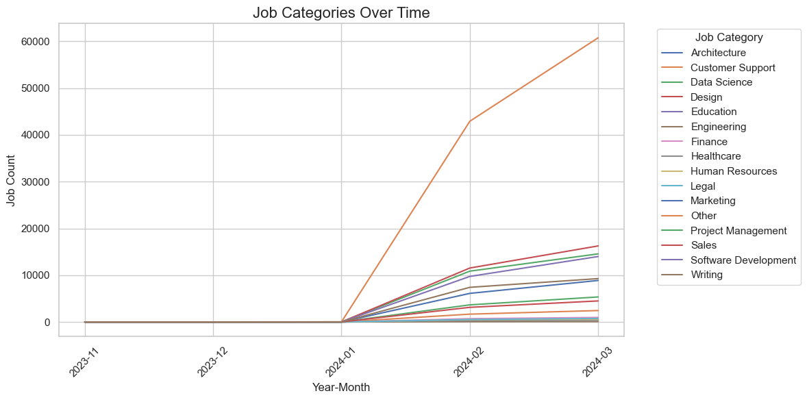
Task 2: Identifying Emerging Job Categories
The chart shows the growth in job postings across various categories over time, with Software Development experiencing a significant surge from January to March 2024. Other categories show steady but smaller increases, reflecting broader demand trends.

Slide 10
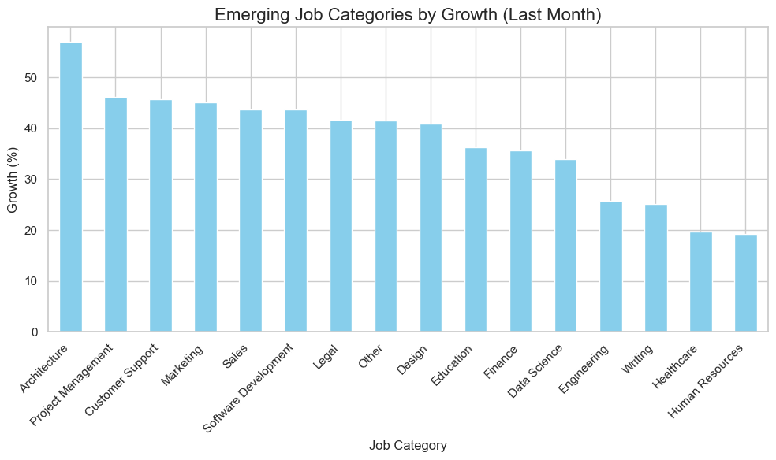
The bar chart highlights Architecture and Project Management as the fastest-growing job categories in the last month, with over 50% growth. Other fields like Customer Support, Marketing, and Software Development also show significant upward trends.

Slide 11
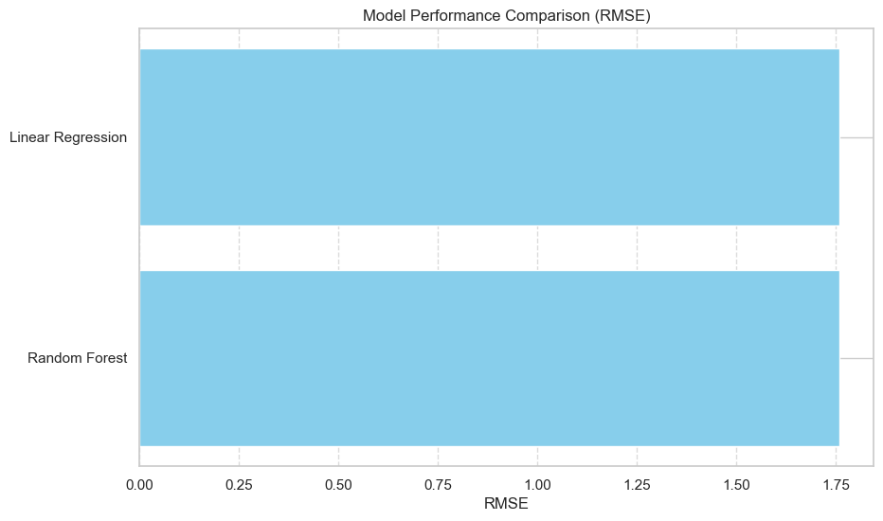
Task 3: Forecasting High-Demand Roles
Both Random Forest and Linear Regression models exhibit identical performance with an RMSE of 1.7586, indicating no significant difference in predictive accuracy for the given dataset.

Slide 12
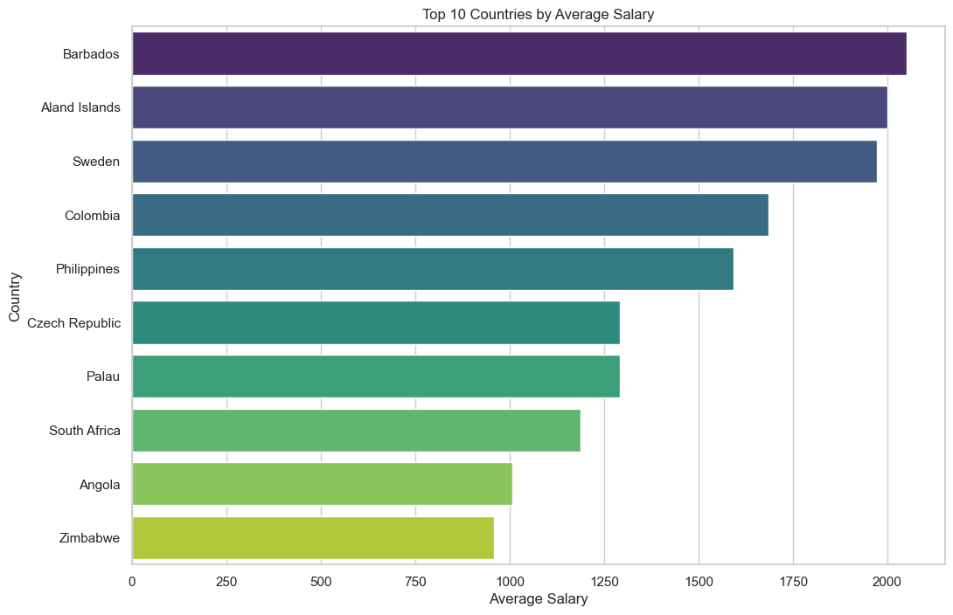
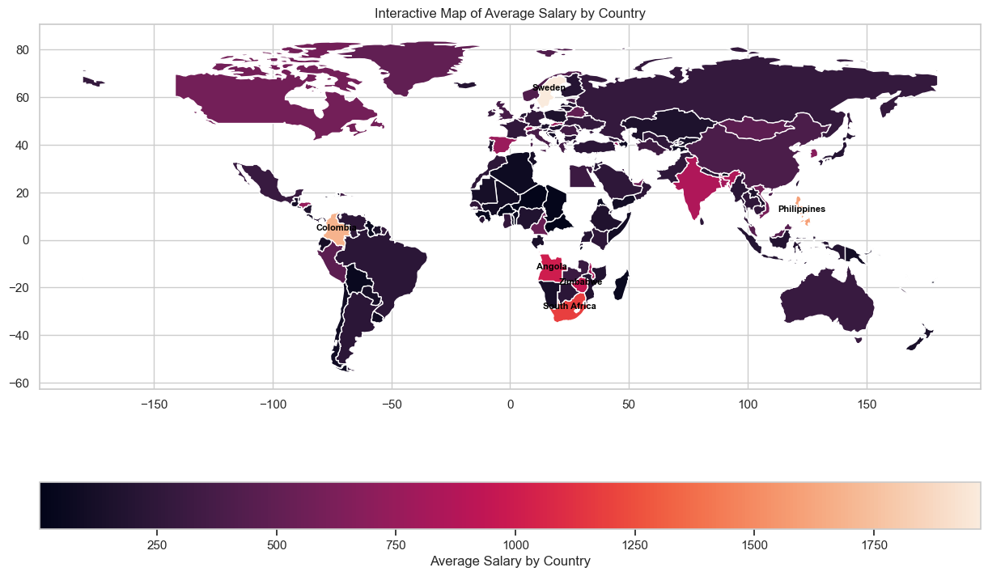
Task 4: Comparative Salary Analysis by Region
This chart depicts the top 10 countries ranked by average salary, showcasing that Barbados leads, followed by Åland Islands and Sweden. The graph highlights variations in income levels across these countries, emphasizing economic disparities globally.

Slide 13
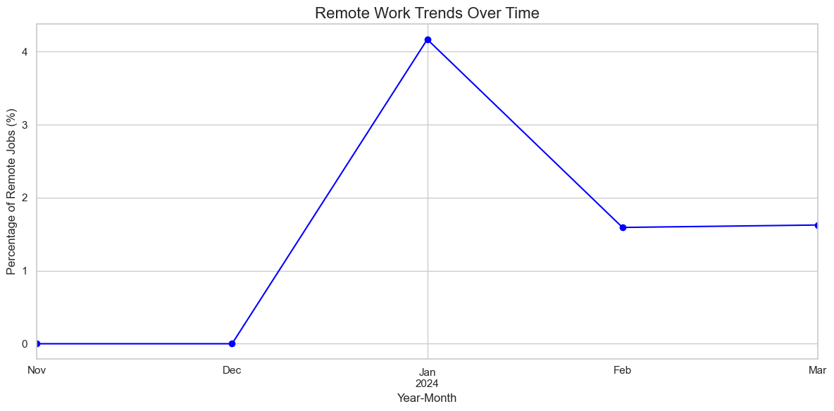
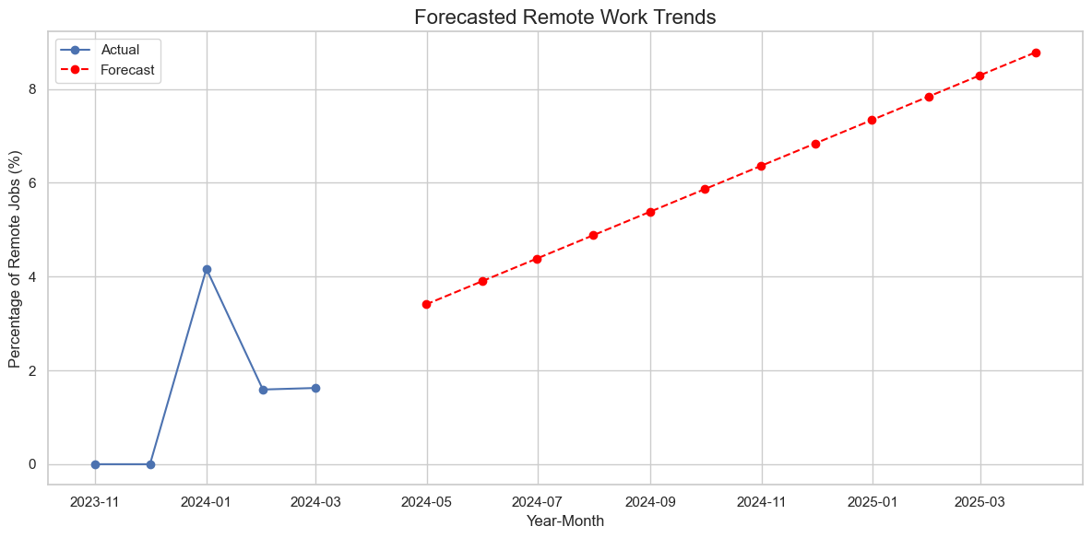
Remote Work Trends Analysis
The graph illustrates the trends in remote job percentages over time, with a significant peak in January 2024, followed by a decline and stabilization in February and March. This indicates a temporary surge in remote work opportunities at the start of the year.
The chart shows actual remote work trends until early 2024, with a peak in January, followed by a stabilization. The forecast suggests a steady increase in remote job percentages from mid-2024 to early 2025, highlighting a growing adoption of remote work.

Slide 14
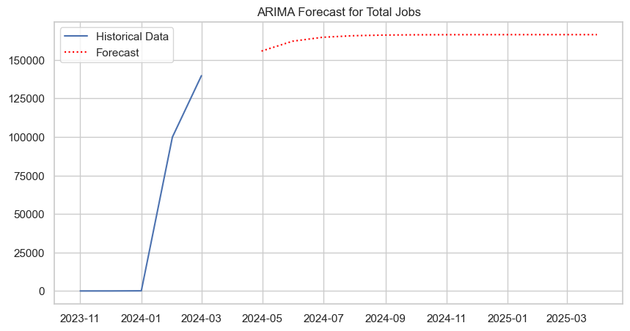
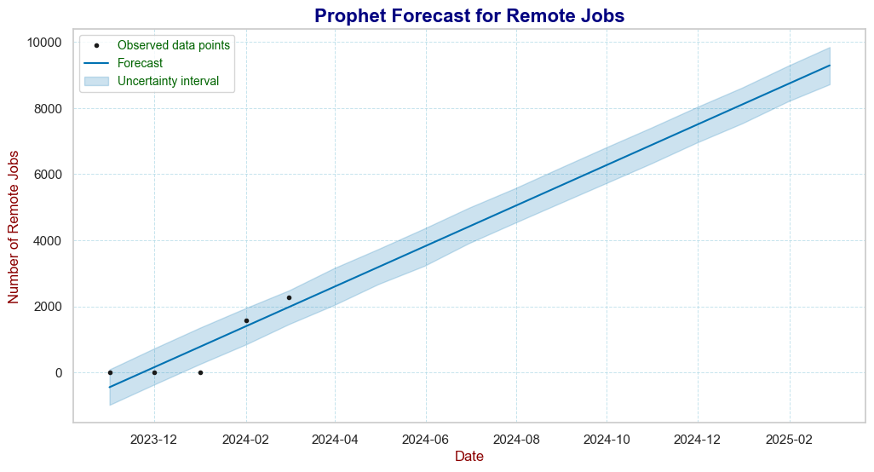
Models Used for Forecasting
ARIMA (Autoregressive Integrated Moving Average)
Prophet
Developed by Facebook for forecasting time-series data. Robust to missing data and outliers. Ideal for seasonal trends in the job market.
Time series forecasting model. Suitable for predicting trends in job openings and remote work.

Slide 15
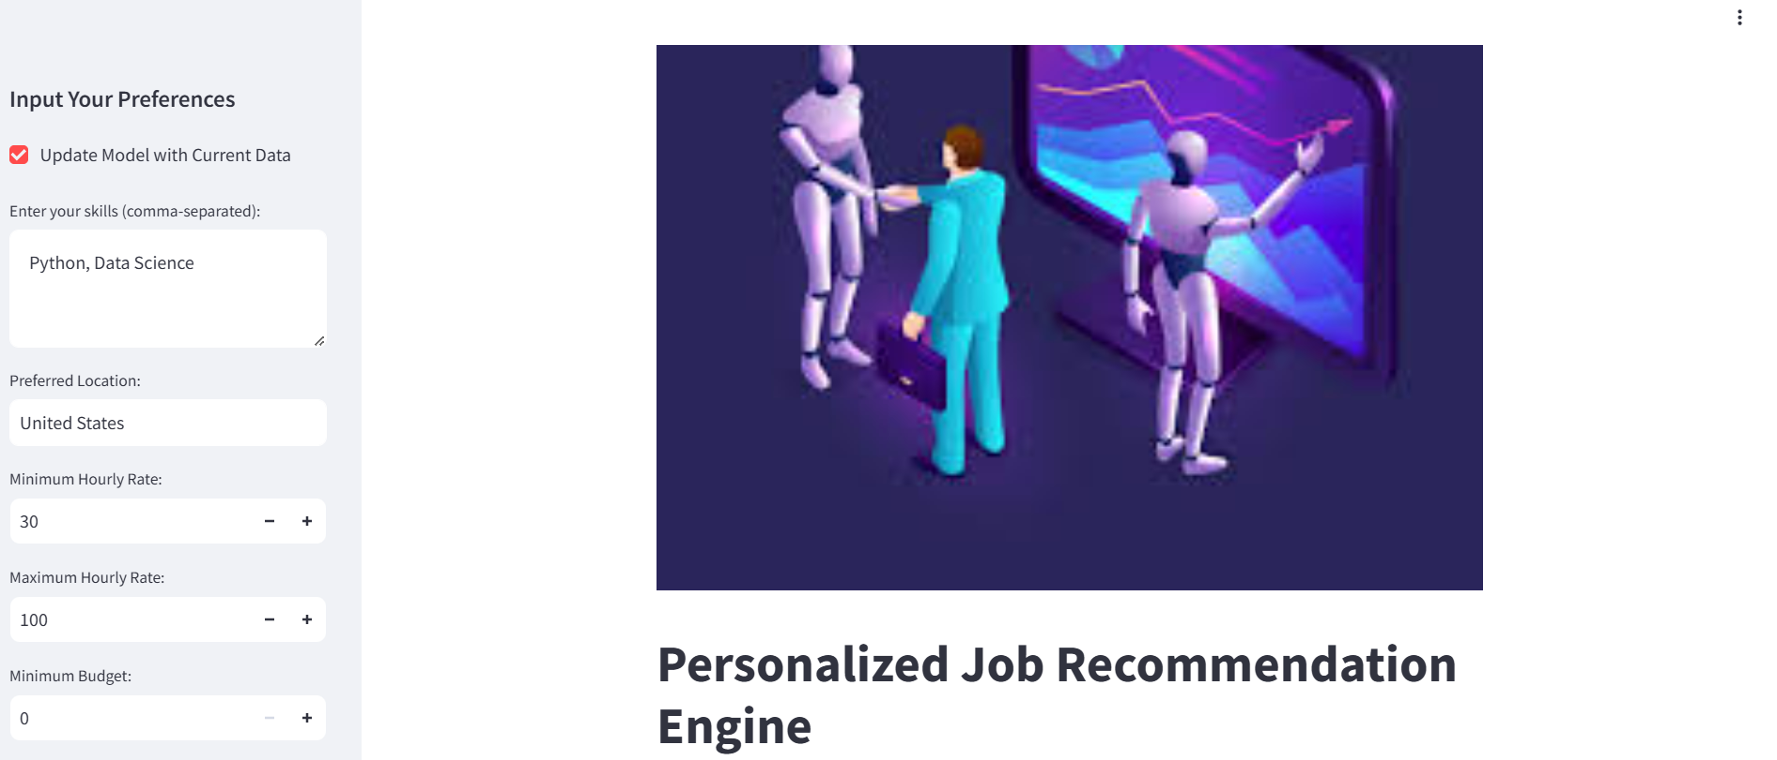
OUTPUTS IN STREAMLIT

Slide 16
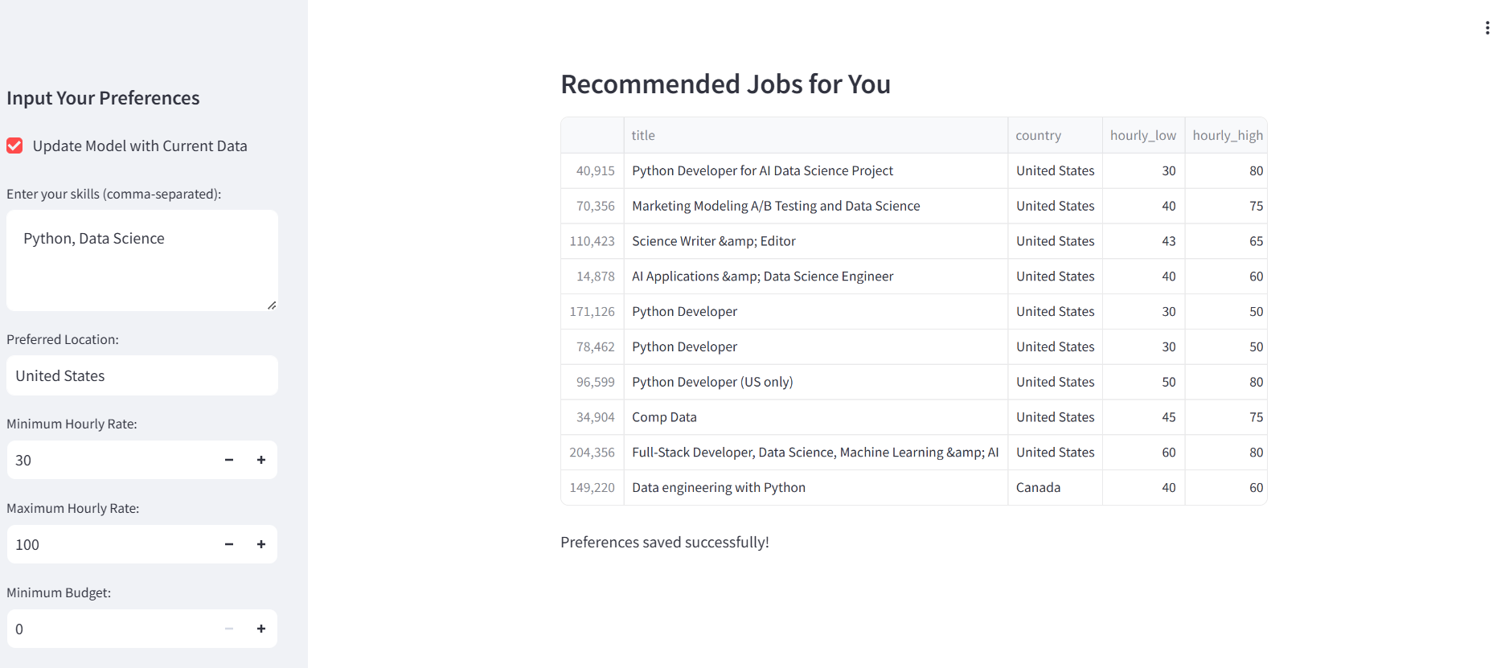

Slide 17
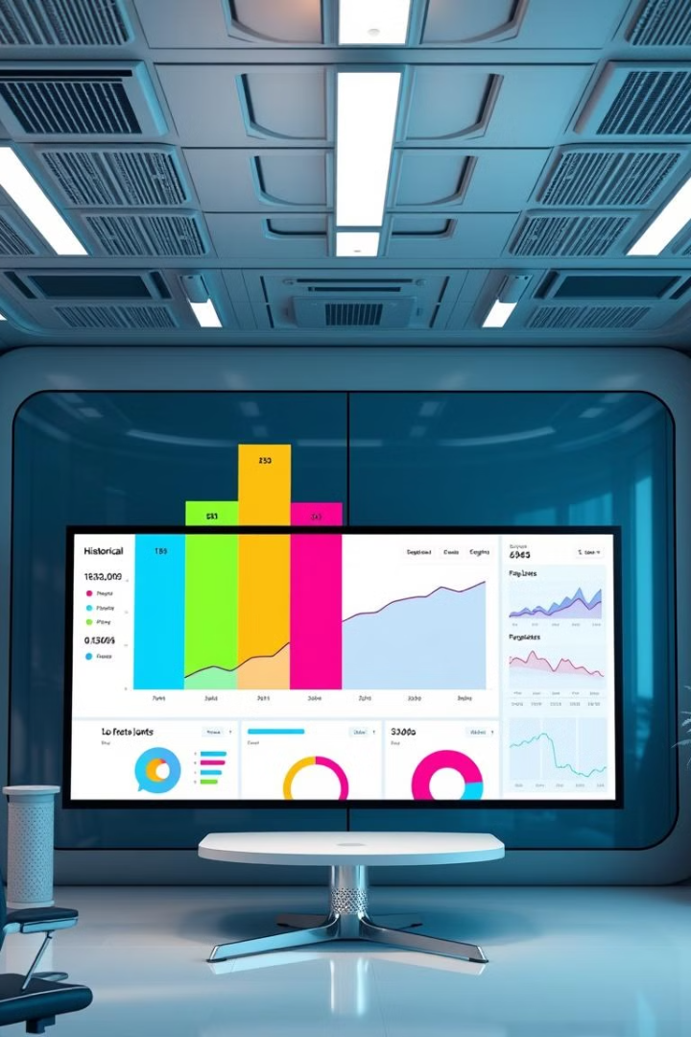
Key Insights from Forecasting
Remote Jobs
Salary Trends
Remote work is projected to continue growing, becoming a larger share of total job openings.
Salaries in tech and healthcare are expected to rise due to increasing demand. Remote job salaries show slight growth due to the competitive job market.
Job Categories
High-demand sectors, such as technology, healthcare, and data science, are expected to lead in job creation.

Slide 18




Recommendations
For Job Seekers
For Employers
For Policymakers
Target roles in high-growth sectors, such as technology, data science, and healthcare. Focus on improving skills related to remote work and digital transformation.
Invest in remote work infrastructure. Upskill your workforce to meet future demands.
Support upskilling initiatives and provide resources for career transitions. Invest in remote work-friendly policies and digital skill training.

